Slide 1
SEXUALLY TRANSMITTED DISEASES

Slide 2
GYNAECOLOGIC INFECTIONS
Dr. A.M. Otara
Senior Lecturer Reproductive Health Department
Specialist Obstetrician& Gynaecologist

Slide 3
SCOPE
Lower genital tract infections
Pelvic inflammatory disease
Pelvic Abscess

Slide 4
LOWER GENITAL TRACT INFECTIONS

Slide 5
Lower Genital Tract Infections
Learning objectives
At the end of this chapter you should be able to:
Define lower genital tract infections.
Outline the characteristics of an abnormal vaginal discharge.
Discuss the causes and management of abnormal vaginal discharge.
Discuss the causes and management of ulcerative genital infections.
Outline the approaches to the control of Sexually transmitted infections.

Slide 6
Abnormal per vaginal discharge
Genital Ulcers

Slide 7
Vaginal Discharge
Physiological
Abnormal
Characteristics
  Amount
  Odour
  Associated features :
    dysuria, dysperunia
    itching, burning sensation
    vulval soreness

Slide 8
Physiological discharge
Discharge from each organ and its characteristics
  Uterine cavity-clear, more copious towards end of cycle
  Cervix – has leucocytes and quantity is influenced by function of ovary and vascularity of the cervix.
  Vaginal wall -cells join up in the secretions therefore semi-solid, opaque & white in colour. It may contain some bacteria (Doderlins bacilli) and amount increases at sexual stimulation.
  Vulval-from Bartholins, sebaceous and sweat glands. The amount varies with ovarian function

Slide 9
Physiological Discharge
Secretory phase of menstrual cycle
Sexual excitement –pre-coital

Slide 10
Leucorrhea
Excess vaginal discharge.
Heavier than usual, but clear. Quantity is 0.67g-1g at ovulation

Slide 11
Leucorrhea
It is noticed at various stages: –
At birth; may be mucoid – occurring 1st-10th/7 after birth of the neonate. Treatment –reassure mother about baby
Puberty-abnormal discharge due to increased activity of hypothalamus and ovarian stimulation by LH to produce estrogens.
Hormones –family planning hormones: COCs.
IUCD
  Douching, FP creams, gels –stimulates secretion.
Cervical Ectopion-Displacement of squamo-columnar junction due to cervical erosion .
Cervical cautery .

Slide 12
Leucorrhea
When wet it is white or creamy. When dry it has a brownish yellow stain on under clothing .
Some leucocytes and pus cells may be seen.
It is a nuisance as it stains clothes, causes soreness but there is no pruritus and has no smell.

Slide 13
Abnormal Vaginal Discharge
Non-infections causes
Chemical irritation; allergy to condom material, douching, contraceptives
Atrophic vaginitis in post-menopausal women
Foreign bodies-tampons,
Neoplasia-Benign e.g. Fibroids, Malignant e.g. CA Cervix

Slide 14
Abnormal Vaginal Discharge
Infections
  T.Vaginalis
  Candida albicans
  N.gonorrhea
  Viral –HSV -rare

Slide 15
Inflammatory Vaginal discharge
The discharge can be mucopurulent or purulent, smelly, associated with vulvitis, dysperunia.
There is a large numbers of polymorphs in the pus

Slide 16
Sexualy Transmitted Infections

Slide 17
Definition
Sexually transmitted diseases are diseases which are predominantly transmitted through sexual contact .
STDs affect any of the genital organs in females and males.

Slide 18
Magnitude
Worldwide at least 250 million new cases of STDs occur each year.
Trichomoniasis : 120m cases / year.
Chlamydia 50 m cases /year

Slide 19
Gender issues
Women are at higher risk compared to men
Limited ability to negotiate safe sex.
Limited access to information and health care.
Larger vaginal surface area more vulnerable to infections.
STIs often asymptomatic in women.
Blood transfusion during delivery predispose to HIV and Hepatitis B.

Slide 20
Trichomoniasis
Caused by T. vaginalis a flagellates that reproduce by binary fusion
Incidence -5 % of women in FP clinic ,13-25% of women in gynaecological clinic, 50-75% in prostitute ,amongst male-also common, 5% of babies born of infected mothers
Features-Greenish yellow discharge, frothy (air bubbles), profuse –on Cusco exam – big pool of fluid in the posterior fornix
Itching can be much and may cause vulval ulcers/cracks
Wet prep under microscope
Treatment:-
  Metronidazole -200mg tds 7/7 or 400mg bid 7/7 --No alcohol.
  Tinidazole (fasigyn)4 tabs stat, can be taken as tablets or pessaries-commonly fasigyn + nystatin
Give dose for spouse as well

Slide 21
Candidiasis/moniliasis
Very common
Discharge is white thick and in in clamps. There is vulval itchiness.
Covers both vulva & vagina –vulvo-vaginitis ,can also be found in ano-rectal area.
Vaginal swab for culture
Speculum exam –vaginal wall lined with thick discharge
Can cause ballanitis (inflammation of prepuce and glans penis)

Slide 22
Candidiasis/moniliasis
It is favoured by some conditions:
Pregnancy glycosuria
Diabetes Mellitus
Oral contraceptive use
Menstruation
Antibiotic therapy-broad spectrum-Tetracycline, cephasporins.
Immune deffiency -HIV, cytotoxics
Prevalence in pregnancy increases in course of gestation and factors in pregnancy making ideal environment for candida include;
Increased estrogen
glycosuria –decreased glucose tolerance
slight increase in vaginal fluid PH

Slide 23
Candidiasis/moniliasis
Treatment is generally topical unless the infection does not respond or recurs frequently.
Systemic treatment and suppression with imidazoles are effective, although long-term use can lead to colonization with resistant candida species
Examples
  Nystatin tabs, vaginally or oral – has poor absorption
  Clotrimazole,Econazole,Miconazole,Bifonazole–Pessaries or cream
  Per oral ; Itraconazole, Fluconazole, Ketoconazole
Other reasons for apparent treatment failure or breakthrough include a second etiologic agent and noninfectious conditions.

Slide 24
Gonorrhoea
Caused by N. gonorrhea, a gram negative intracellular diplococcus.
Sexual spread to the uterine cervix. Incubation period is 2-14days.
Majority of men are symptomatic and 2/3 of women are asymptomatic.
Features include; per urethral discharge –purulent, dysuria, dysperunia. Pelvic inflammation with backache & lower abdominal pain
Manifests in 1st 10/7 of menstrual period

Slide 25
Chlamydia
Caused by C. trachomatis, Gram negative, intra-cellular obligate organism, infects epithelial cells of the urethra, conjunctiva, cervix and fallopian tubes (pathogen of mucus membranes).
Serovariants that produce different lesions:L1-3: LGV;
A, B, Ba, C :Trachoma; B-K:cervicitis, salpingitis, non-gonococcal urethritis, neonatal conjunctivitis and pneumonia
Isolated in upto 70% of men with non-specific urethritis.
Thought to be 2° infection to patients with gonorrhea
Causes cervicitis and vaginitis, but has been isolated in cervix of asymptomatic women or fallopian tubes.
Associated with occasional pain when erect in men
Culture –not routine in all laboratories.
Treatment– Tetracycline, for 2/52 to be effective

Slide 26
Bacterial vaginosis
Gardnerella
KOH -fishy smell

Slide 27
Ulcerative lnfections
Syphylis
Chancroid
  Haemophilus ducreyi infection is especially common in women from developing countries.
Herpes Simplex Virus II

Slide 28
Herpes Simplex Virus II
Vaginal discharge –clear, watery associated with pain
Vesicles at cervix & vulva –burst after a few days and may ulcerate
Viral inclusion bodies in cytological smears
Treatment –Acyclovir 200mg, Famciclovir
Supportive therapy: treat 2° infections , analgesics – painful

Slide 29
HIV
Women represent one of the fastest growing populations infected with the human immunodeficiency virus (HIV)
There remain significant gender-based differences in the disease. These include:
  Differences in viral load early in infection
  Differences in selected opportunistic infections
  A number of female-specific complications
  Issues related to HIV and pregnancy
  The psychosocial impact and the environment in which HIV/AIDS occurs in women

Slide 30
HIV
For many women, gynecologic complaints are the initial manifestation of HIV/AIDS.
These conditions, which also exist in uninfected women, can occur with higher frequency and severity in women with HIV.
  Candidia vaginitis
  Abnormal cervical cytology
  Pelvic inflammatory disease
  Genital ulcer disease (eg, HSV, chancroid, syphilis)
  Menstrual disorders

Slide 31
Approaches to the control of Sexually Transmitted Infections
STIs constitute a huge and economic burden for developing countries: 75-85% of the estimated 340 million annual new cases of curable STIs occur in these countries.
The control of STIs can reduce HIV transmission.
STI control programmes have 3 objectives;
  To interrupt transmission of STIs
  To prevent the development of disease complications and sequelae
  To reduce the transmission of HIV infection

Slide 32
Approaches to the control of Sexually Transmitted Infections
Interventions to reduce incidence and prevalence of STIs include;
Primary prevention by;
  Information, education and communication campaigns
  Condom promotion
  Use of safe microbicides
  Vaccines
Screening and case finding amongst vulnerable groups e.g. pregnant women
STI case management using syndromic approach
Targeted interventions for populations at risk e.g sex workers
(4 Cs: counseling,condoms, compliance with treatment, contact tracing)
Targeted periodic mass treatments.

Slide 33
PELVIC INFLAMMATORY DISEASE

Slide 34
Pelvic Inflammatory Disease
Learning objectives
At the end of this chapter you should be able to:
Define pelvic inflammatory disease(PID).
Discuss the epidemiology of PID.
Outline the aetiological agents in PID.
Discuss the pathogenesis of PID.
Discuss the patho-physiology of PID
Describe the diagnosis of PID
Outline the differential diagnosis of PID
Discuss the treatment and follow-up of a patient with PID and its’ complications.

Slide 35
Definition
An infection of the upper genital tract:-cervix, uterus, tubes, ovaries & surrounding peritoneum.
Usually bilateral
Sexually active women
Age; common in <25yrs, in postmenopausal associated with malignancy

Slide 36
Epidemiology
No accurate data on prevalence
1 million women have an episode of acute PID in a year
100,000 become infertile annually as a result of PID
150 deaths annually from PID complications
PID is uncommon in pregnancy

Slide 37
Aetiology
Causative Organisms; C. trachomatis, N. gonnorhea, H. Influenza, Group B & D streptococcus, E. coli, Mycoplasma hominis, anaerobic gram +ve cocci, Bacteroides sp, Clostridium sp.
Sexual spread through the uterine cervix to the tubal mucosa where it attaches to the epithelium and invades the cells.

Slide 38
Spread Mechanisms
There is free passage from external into the peritoneal cavity.
Potential infectious sites adjacent to vagina ;
  urethra anteriorly
  the anus posteriorly .

Slide 39
Defense Mechanisms
There are natural defenses that prevent easy passage of organisms:-
Vulva
  inherent resistance to infection, unless traumatized
  secretion by apocrine glands –rich in undecylenic acid a strong antifungal secretion
  Natural apposition of the two vulva lips (lateral)

Slide 40
Defense Mechanisms
Vagina
  Natural apposition – (AP)
  Stratified squamous epithelium
  Acidity-enhanced by vaginal flora eg Doderlin’s bacilli(lactobacilli)-act on Lactogen producing lactic acid which decreases pH.
Cervix –mucus plug.
Uterine cavity –cyclic shedding of endometrium

Slide 41
Defense Mechanisms
The efficiency of these mechanisms are reduced with:
Age –very young –lack apocrine glands and Lactobacilli. Menopause-reduced defense
Menses –Mucus plug shed off, alkalinity increases, Gonococcus is more virulent if contracted at this time

Slide 42
Defense Mechanisms
Puerperium –Period upto 6/52 post delivery
decreased defense due to :
raw area left by placenta acting as an hideout
breakdown in cervical, vaginal epithelium
bruising and devitalization of tissues at birth
Gapping of vagina and cervix post delivery
Lochia –decreases vaginal acidity therefore pathogens multiply
Blood clots & decidua – good culture media

Slide 43
Risk Factors
Multiple sexual partners > 2 in 30days
Previous PID
Non-use of barrier contraception
IUD increases risk 6fold in 3weeks of insertion
Immuno-suppression
Recent instrumentation of the genital tract

Slide 44
Pathophysiology
Bacterial colonization of the cervix ascends to the uterus, fallopian tubes and ovaries
Gonnorhea and chlamydia are typically isolated from the cervix in PID, but rare in the ovarian tissue; they facilitate infection of the adnexia by other bacteria( polymicrobial process)
Vaginal flora associated with PID include; anaerobes, G. vaginalis, H. influenza, G-ve rods, M. hominis,

Slide 45
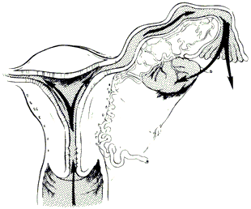
Mode of transmission
Ascending infection (Canalicular spread)
Ascent of gonococcal & chlamydial organisms by surface extension from the lower genital tract through the cervical canal by way of the endometrium to the fallopian tubes
Facilitated by the sexually transmitted vectors such as sperms & trichomonads
Reflux of menstrual blood along with gonococci into the fallopian tubes may be the other possibility

Slide 46
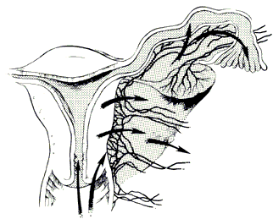
Mode of transmission
Through uterine lymphatic & blood vessels across parametrium
Mycoplasma hominis
Secondary organisms

Slide 47
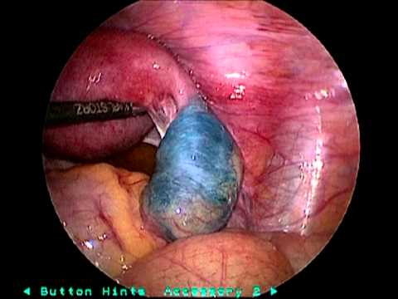
Mode of transmission
Gynecological procedures favoring ascend of infection
E.g. D&C, D&E
Blood-borne transmission
Pelvic tuberculosis
Direct spread from contaminated structures in abdominal cavity
E.g. Appendicitis, cholecystitis

Slide 48
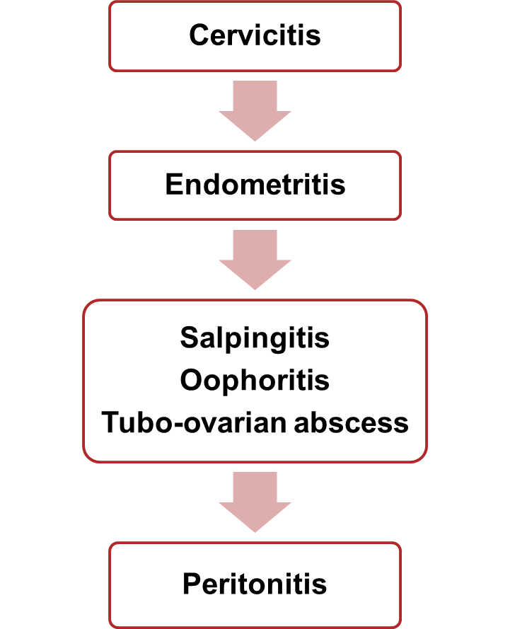
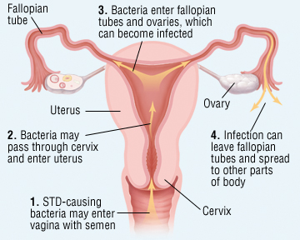
Acute PID : Pathology

Slide 49
Acute PID : Pathology
Involvement of the fallopian tubes is almost bilateral
Pathological process is initiated primarily in the endosalpinx
It usually follows menses due to loss of genital defence
Gross destruction of epithelial cells, cilia & microvilli
Acute inflammatory reaction: all layers are involved
Tubes become edematous & hyperemic; exfoliated cells & exudate pour into lumen & agglutinate the mucosal folds
Abdominal ostium: closed by edema & inflammation
Uterine end: closed by congestion

Slide 50
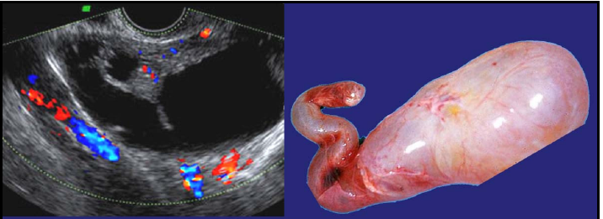
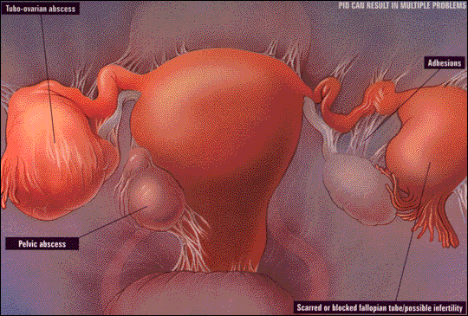
Acute PID : Pathology
Depending on the virulence: watery or purulent exudate
Hydrosalpinx or Pyosalpinx
Deeper penetration & more destruction
Possibilities
Oophoritis
Tubo-ovarian abscess
Peritonitis
Pelvic abscess
or
Resolution in 2-3 weeks with/without chronic sequelae

Slide 51
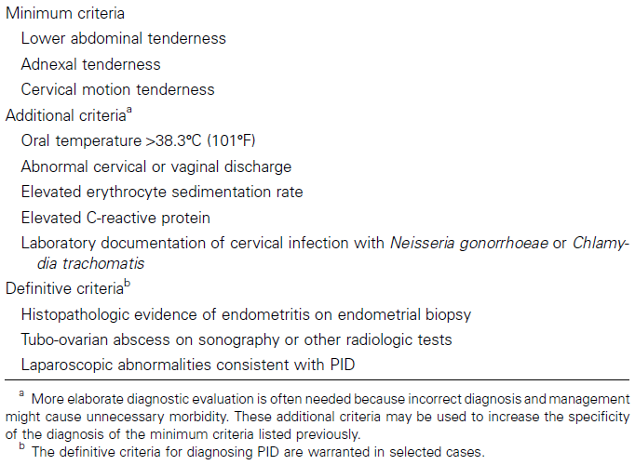
Acute PID : CDC Diagnosis Criteria
3
5
3

Slide 52
Acute PID : Presentation & Diagnosis
Investigations
Complete blood count: Wbc count> 10,000/ml,
C – reactive protein; elevated
Erythrocyte sedimentation rate: elevated
Urine Pregnancy Test (UPT), urinalysis
Urine culture
Urine NAATs
Vaginal/endocervical wet mount
1. WBCs suggest PID
2. Cervical chlamydia and gonorrhea testing (gram negative diplococci.)
3. Nucleic acid amplification tests (NAATs) for organisms
Faecal occult blood test
Tests for tuberculosis
Tests for syphilis
Tests for HIV

Slide 53
Acute PID : Presentation & Diagnosis
Imaging
Transvaginal ultrasonography is the imaging modality of choice
Trans abdominal ultrasonography for DD
Abdominal CT or MRI : thickened tubes, fluid
Diagnostic procedures
Culdocentesis
Endometrial biopsy
Diagnostic laparoscopy:the definitive test; hyperaemia of the external tubal surface, tubal edema, sticky exudate
Transvaginal U/S, MRI-

Slide 54
Acute PID : Staging
(I-IDSOG-USA recommends following stages)
Stage I
Women who fulfil the CDC major diagnostic criteria and >1 of its minor criteria but who do not have overt peritonitis (as demonstrated by the absence of rebound tenderness) and who have not had any prior documented STD upper tract infections
Stage II
The above criteria, with peritonitis
Stage III
Women with demonstrable tubo-ovarian complex or tubo-ovarian abscess evident on either physical or ultrasonographic examination
Stage IV
Women with ruptured tubo-ovarian abscesses

Slide 55
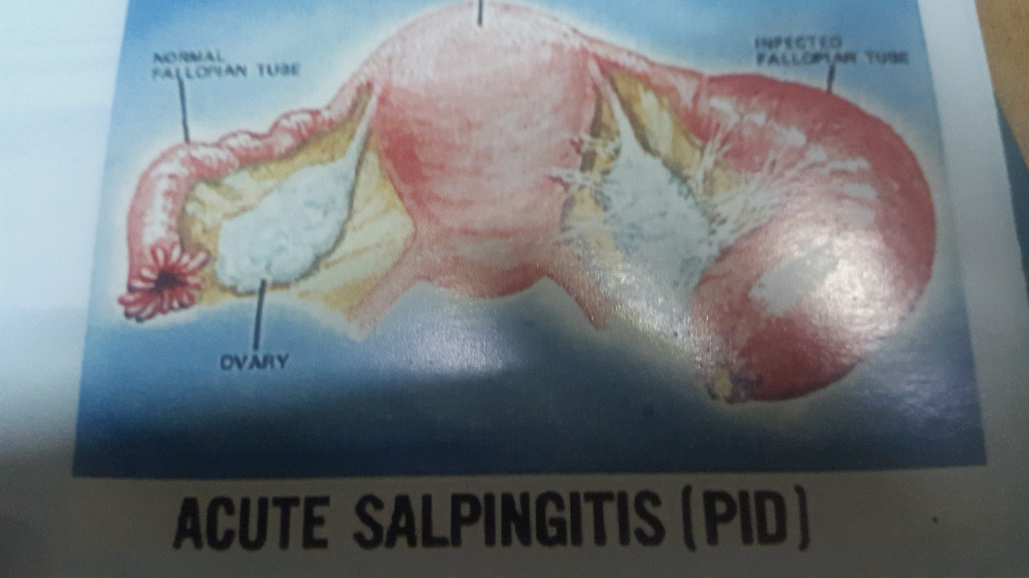

Slide 56
Differential Diagnosis
Infections;appendicitis,diverticulitis,cystitis, septic abortion
Tumors/malignancy
Ectopic pregnancy
Adnexal torsion
Degenerating fibroid
Endometriosis
UTI
Regional enteritis or ulcerative cotitis

Slide 57
Complications
Peritonitis –local pelvic peritonitis or spreads to spleen, liver as Fitz-Hugh-Curtis (perihepatitis-’Violin strings ‘ on laparoscopy), Generalized peritonitis.
Paralytic ilieus leading to chronic distension then electrolyte imbalance
Abscess formation
  Pyosalpinx –tube
  Tubovarian abscess
  POD abscess
Long-term; Infertility (commonest cause), adhesions in the pelvis , chronic pelvic pain, intestinal obstruction due to adhesions.
Gonococcal arthritis –rare
Septic shock

Slide 58
Treatment
Out-patient
If mild or moderate- oral or parentral therapy has similar efficacy
Analgesics incase of fever with minimal abdominal findings give–Iboprufen, mefnamic acid,ASA
Bed rest for 1 week

Slide 59
Treatment
Outpatient treatment
High dose antibiotics
  Penicillin -4.8 mU with probencid lg oral dose followed with 10 – 14 days of,Doxycycline 100mg –
  -Cefoxitim 2g 1m start followed by Doxycycline or tetracycline
  Amoxicillin or Ampicillin stat, followed with Doxycycline or tetracycline.
  Quinolones- Ofloxacin400mg bid or Levofloxacin 500mg od +/- Metronidazole 500mg bd for 14 days
  3rd/4th gen Cephalosporins e.g. i.m. cefoxitin stat + Doxcycline 100mg bd +/- Metronidazole 500mg bd for 14 days
Treat the partner
Review patient in 3-4 days – If not better admit.

Slide 60
Treatment
In-patient
CDC criteria for hospitalization-surgical emergency, pregnancy, no response to oral antibiotics, unable to tolerate or follow Rx, vomiting, tubo-ovarian abscess
3rd Generation cephalosporin- cefotetan,cefoxitin 2g i.v bd+ Doxcyline 100mg po or iv bd
Clindamycin 900mg iv tds+Gentamicin 1.5mg/kg tds
No improvement;laparascopy/laparotomy

Slide 61
Prevention
Health education.
Risks of multiple partners .
Youth separately, ie.isolated clinics.
Contact tracing & early detection in male with asymptomatic.

Slide 62
Follow-up
Improvement within 72 hours, re-evaluate
Contact tracing, treatment and education
Referral
25% risk of long-term sequelae; infertility ectopic pregnancy and chronic pelvic pain
Fitz-Hugh-Curtis syndrome- fibrous peri-hepatic adhesions

Slide 63
PELVIC ABSCESS

Slide 64
Pelvic Abscess
Learning objectives
At the end of this chapter you should be able to:
Define pelvic abscess.
Discuss the pathogenesis of Pelvic abscess.
Describe the diagnosis of Pelvic abscess
Discuss the treatment and follow-up of a patient with Pelvic Abscess and its’ complications.

Slide 65
Introduction
A collection of pus within pelvis created by adherence of adjacent organs.
Most abscesses occur in the pouch of Douglas, on the adnexia as tubo-ovarian abscess and rarely broad ligament abscess.
Most abscesses are polymicrobial.
Follows recurrent PID,abortion, puerperal sepsis, gynaecologic cancer, gynaecologic surgery and procedures.
Common in HIV/AIDS.

Slide 66
Clinical presentation
Lower abdominal pain and swelling
Cervical discharge.
Painful defecation and lower back pain.
Fever, nausea, tachycardia, malaise
Fluctuant mass filling the cul-de-sac.
Laboratory tests are of little value in diagnosis; leucocytosis, ESR, C-reactive proteins.
Diagnosis: paracentesis, culdocentesis. Pelvic ultrasound scan.

Slide 67
Treatment
Supportive care with intravenous fluids, parenteral antibiotics, naso-gastric intubation, transfusion.
Surgery; emergency surgery in suspicion of rupture of abscess to avoid fulminant peritonitis.
U/S or CT guided percutenous drainage of the pus and irrigation may be successful in 75-84% of cases.
Laparotomy- break the pus locules, releases adhesions, drainage of pus. Salpingectomy if there is pyosalpinx.
Posterior colpotomy with dissection of the sacules then drainage.

Slide 68
Complications
Recurrence
Bowel obstruction
Ectopic pregnancy
Infertility
Chronic pelvic pain
Visceral injury at laparotomy

Slide 69
Management : Surgery in PID
(Main complications in Stage IV PID : Ruptured abscess)
During operation
1. Septic shock
2. Injury to small bowel
3. Injury to rectum
Post-operative
1. Pus collected again
2. Chest empyema
3. Septicemia
4. Septic shock
5.. Recto-vaginal fistula
6. Wound abscess or infection
7. Pneumonia
8. Renal failure
9. Liver failure

Slide 70
Prevention
Non-pharmacologic; health education, prevention of STI, barrier methods, contact tracing, avoid IUCD in high risk.
Prompt diagnosis and treatment of PID
Vaccines; chlamydia

